Slide 1
MARKETING CAMPAIGN ANALYSIS
Course 5- Exploratory Data Analysis using PowerBi
Presentation by Prashant

Slide 2
AGENDA
Objective:
1. Project Overview
2. Data Understanding
3. Data Model
4. Key Metrics & KPIs
5. Customer Demographics
6. Spending Patterns
7. Campaign Performance
8. Purchase Behaviour
9. Key Insights
10. Recommendations & Next Steps

Slide 3
PROJECT OVERVIEW
Objective: Analyze customer data to optimize marketing campaigns
Data Source: Marketing Campaign Dataset
- 2,241 Customer Records
- 29 Original Columns
- 6 Calculated Columns
Key Questions:
Who are our most valuable customers?
Which products generate the most revenue?
Which marketing campaigns work best?
How do demographics affect spending and responses?

Slide 4
DATA UNDERSTANDING
Dataset Overview:
• Total Records: 2,241
• Total Columns: 35 (29 Original + 6 Calculated)
Key Variables:
• Demographics: Age, Education, Income, Marital Status
• Spending: Wine, Meat, Fish, Fruits, Sweets, Gold
• Campaigns: AcceptedCmp1-5, Response
• Purchases: Web, Store, Catalog, Deals
• Engagement: Web Visits, Recency
Data Cleaning Performed:
✅ Removed duplicates
✅ Handled missing values
✅ Removed outliers
✅ Created calculated columns

Slide 5
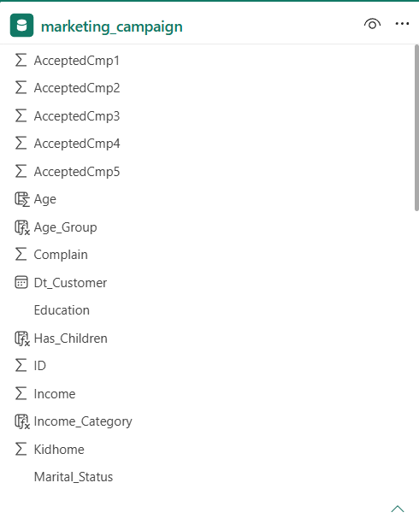
DATA MODEL
Single Table Model - marketing_campaign
• Primary Key: ID
• 29 Original Columns
• 6 Calculated Columns: Age, Total_Spending, Total_Accepted, Income_Category, Has_Children, Age_Group
• 2,241 Total Records

Slide 6
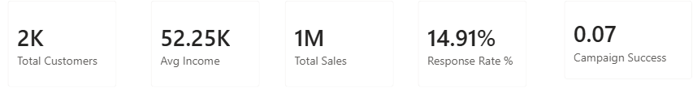
Key Metrics & KPIs
Key Observation:
• Total Customers: 2,241
• Average Income: 52,2500
• Total Sales: ~1 Million
• Response Rate: ~14.91%
• Campaign Success: ~0.07%

Slide 7
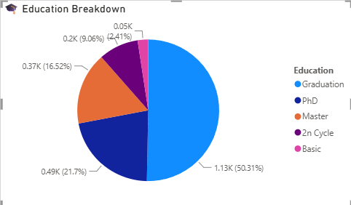
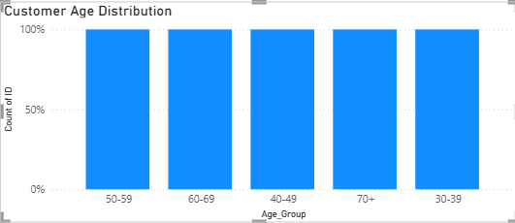
Customer Demographics
Age Distribution:
• Majority of customers are 40-60 years old
Education Level:
• Most customers have Graduate degrees
Income Distribution:
• Median income around $50,000
🎯 Target Audience: Middle-aged, educated, middle-high income

Slide 8
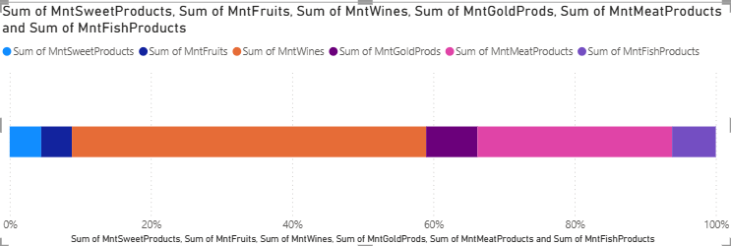
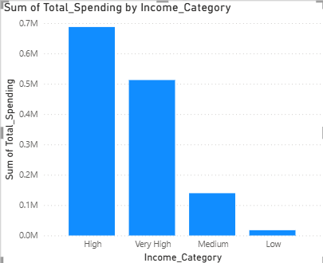
Spending Patterns
Top Product Categories:
1. Wine 🍷 (Highest)
2. Meat Products 🥩 (Second)
3. Gold Products 🥇 (Third)
Spending by Income:
• Very High Income: Spend 3x more than Low Income
💡 Insight: Focus premium products on high-income customers

Slide 9
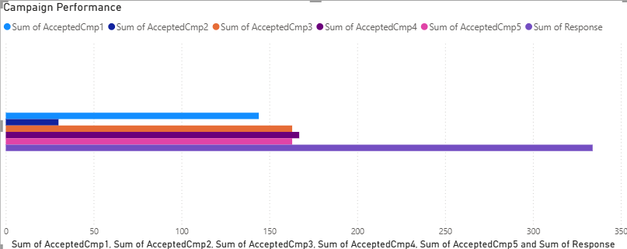
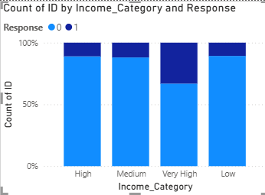
Campaign Performance
Campaign Success:
Campaign 5: Highest (Best)
Campaign 1: Moderate
Campaign 2: Moderate
Campaign 3 & 4: Lower
Response by Demographics:
• Very High Income: Highest response rate
• PhD & Master: Best response rate
💡 Strategy: Target high-income, educated individuals

Slide 10
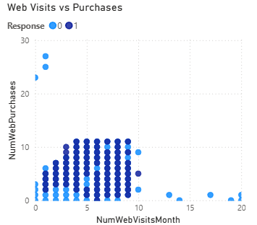
PURCHASE BEHAVIOR
Purchase Channels:
Web: Most Popular
Store: Second
Catalog & Deals: Lower
Web Engagement:
• More visits = More purchases
• Responders visit more often
💡 Recommendation: Invest in web experience & mobile optimization

Slide 11
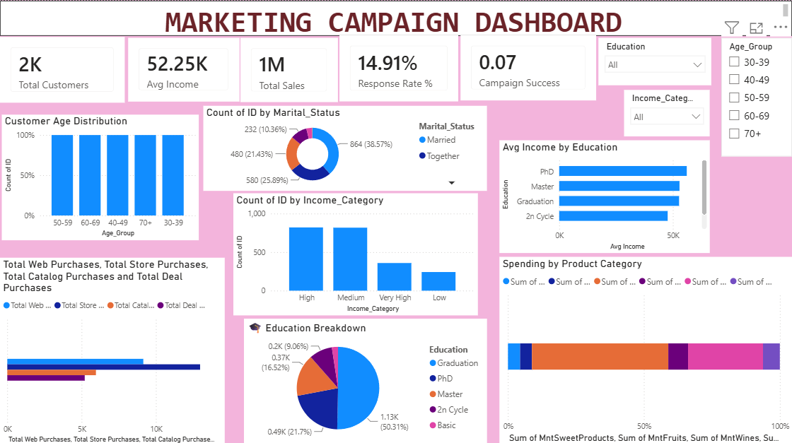
Dashboard

Slide 12
KEY INSIGHTS & RECOMMENDATIONS
INSIGHTS:
• Customers: 40-60 yrs, Graduate+, ~$50k income
• Top Products: Wine > Meat > Gold
• Best Campaign: Campaign 5
• Top Channel: Web
• Response Rate: ~15%
RECOMMENDATIONS:
✅ Campaign 5 strategy for High Income + Educated
✅ Bundle Wine + Meat + Gold
✅ Invest in Web experience
✅ Loyalty program for Top 20%
NEXT STEPS:
📌 Implement campaigns | Track weekly | Refine quarterly

Slide 13
Thank you
Presentation By Prashant

